Slide 1
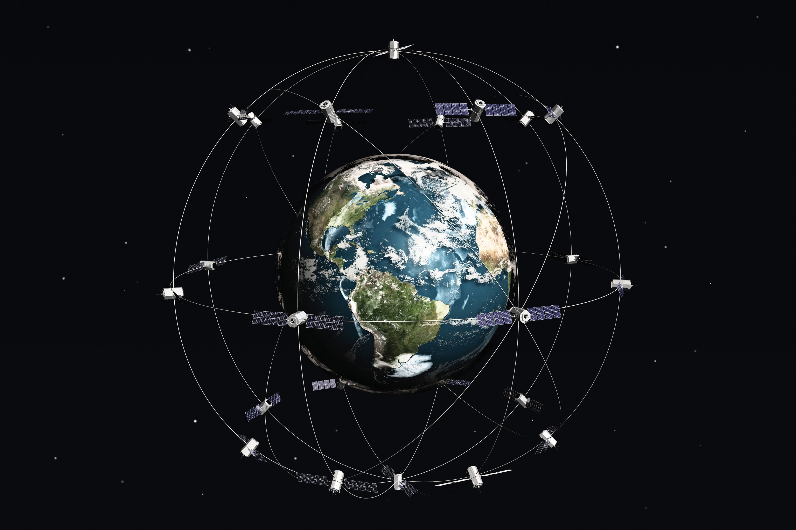
Gravitational Force and Weight
Gravitational force is the force that the Earth exerts on any object. It is directed toward the center of the Earth.
The magnitude of the gravitational force is equal to the product of mass and acceleration due to gravity.
The weight W of a body is the magnitude of the net force required to prevent the body from falling freely, as measured by someone on the ground.
The weight W of a body is equal to the magnitude of the gravitational force on the body. A body’s weight is related to the body’s mass by,

Slide 2
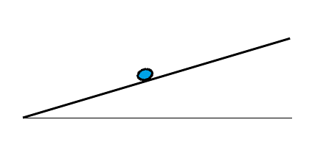
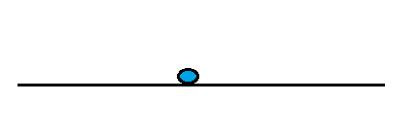
Normal Force

Slide 3
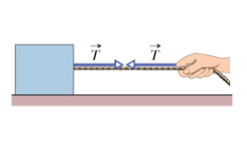
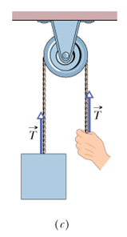
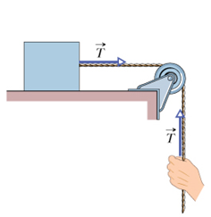
Tension
This is the force exerted by a rope or a cable attached to an object. Tension has the following characteristics:
It is always directed along the rope.
It is always pulling the object.
3. It has the same value along the rope.
The following assumptions are made:
The rope has negligible mass compared to the mass of the object it pulls.
The rope does not stretch.
If a pulley is used, we assume that the pulley is massless and frictionless.

Slide 4
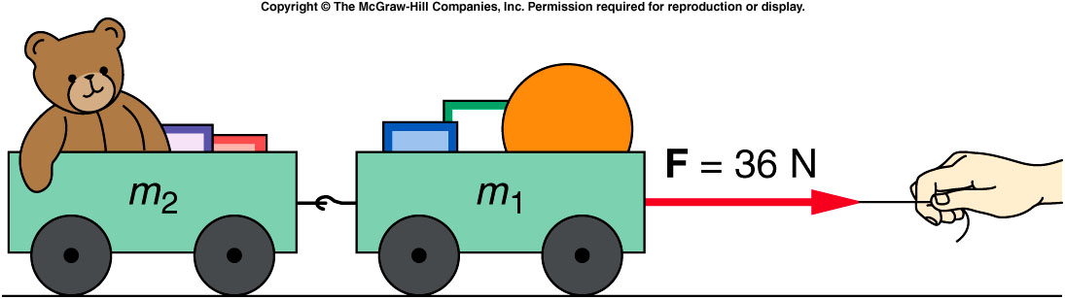
Motion of Connected Objects
m₁= 10 kg
m₂= 8 kg
What is the acceleration of the two carts?
What is the net force acting on each cart?

Slide 5
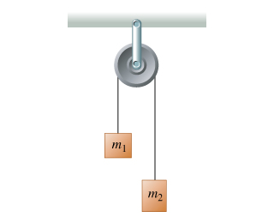
Atwood Machine

Slide 6
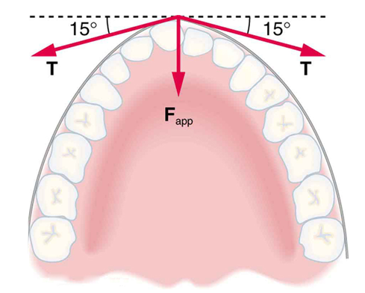
Force exerted on tooth by braces
33. What force is exerted on the tooth in Figure 4.38 if the tension in the wire is 25.0 N?

Slide 7
Problem 42
42. A 76.0-kg person is being pulled away from a burning building as shown in Figure 4.41. Calculate the tension in the two ropes if the person is momentarily motionless.

Slide 8
4.8 Types of Forces:
In nature there are two general types of forces, fundamental and non-fundamental.
Fundamental forces:
  Gravitational force
  Strong nuclear force
  Weak nuclear force-----|
  Electromagnetic force--!—The last two are unified….Electroweak force
Non-fundamental forces:
Pushing, Pulling, Kicking, Grabbing, etc….
These are related to the electromagnetic force. They arise from the interactions between the electrically charged particles that comprise atoms and molecules.

Slide 9
Fundamental (Basic) Forces
Fundamental Force | Example | Particles Affected | Relative Strength | Carrier Particle
Strong nuclear | Nucleus | Nuclear | 1 | Gluon
Electromagnetic | +, - Charges | Charged | 10⁻² | Photon
Weak nuclear | Radioactivity | Nuclear | 10⁻¹³ | Boson
Gravitational | Your weight | All | 10⁻³⁸ | Graviton

Slide 10
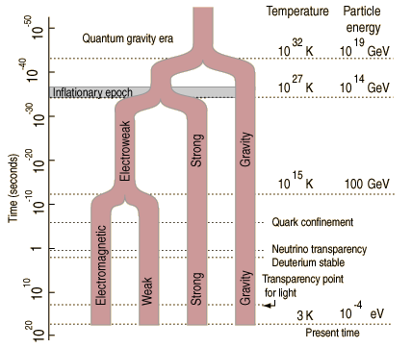
Unification of Fundamental Forces

